Slide 1
Topic 8
Data Hazards

Slide 2
Hazards
Situations that prevent starting the next instruction in the next cycle
Structure hazards
  A required resource is busy
Data hazard
  Need to wait for previous instruction to complete its data read/write
Control hazard
  Decision on control action depends on previous instruction

Slide 3
Structure Hazards
Conflict for use of a resource
If common memory for program and data
  Load/store requires data access
  Instruction fetch would have to stall for that cycle
    Would cause a pipeline “bubble”
Hence, pipelined datapaths require separate instruction/data memories
  separate instruction/data caches (Harvard)
  Common low-level memory (Von Neumann)

Slide 4
Data Hazards in ALU Instructions
Consider this sequence:
  sub $2, $1,$3
  and $12,$2,$5
  or $13,$6,$2
  add $14,$2,$2
  sw $15,100($2)

Slide 5
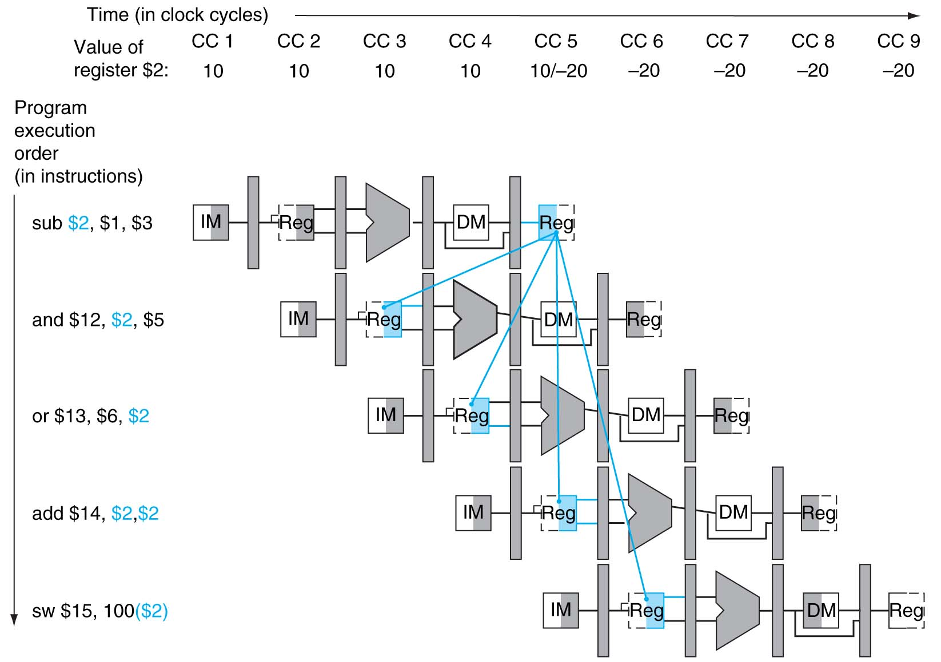
Data Dependencies
OK dependencies

Slide 6
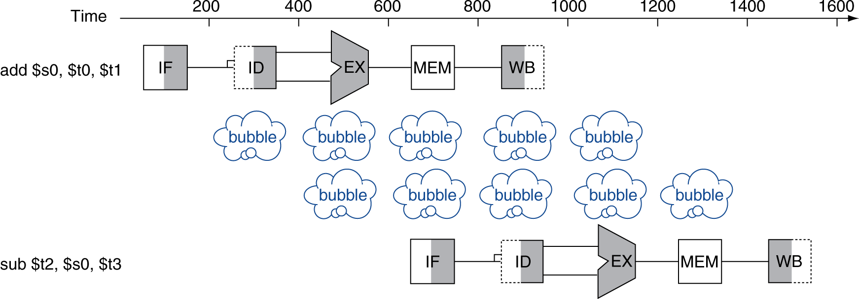
Data Hazards
An instruction must be delayed
  If an instruction depends on completion of data access by a previous instruction
  By inserting bubbles or stalls
  Example
  add $s0, $t0, $t1
  sub $t2, $s0, $t3
nop
nop

Slide 7
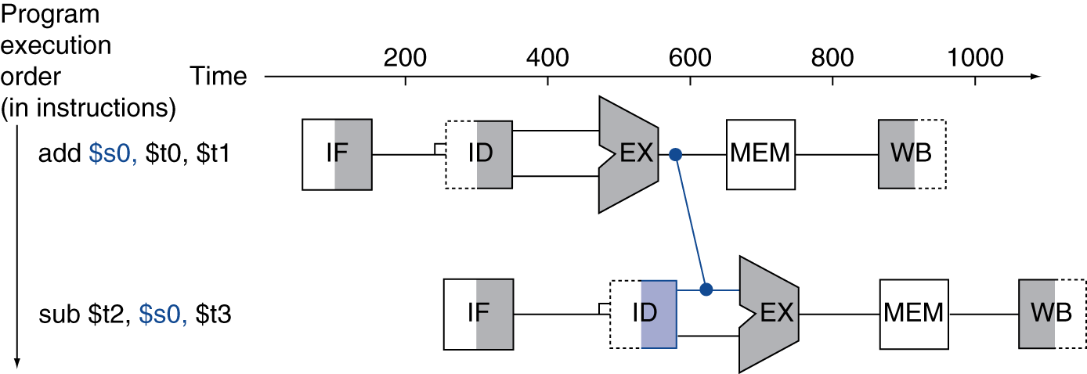
Forwarding (aka Bypassing)
Data hazard can be solved with Forwarding
  To avoid delaying an instruction
Use result as soon as it is computed
  Don’t wait for it to be stored in a register
  Requires extra connections in the datapath
Can’t connect input and output of a
component directly

Slide 8
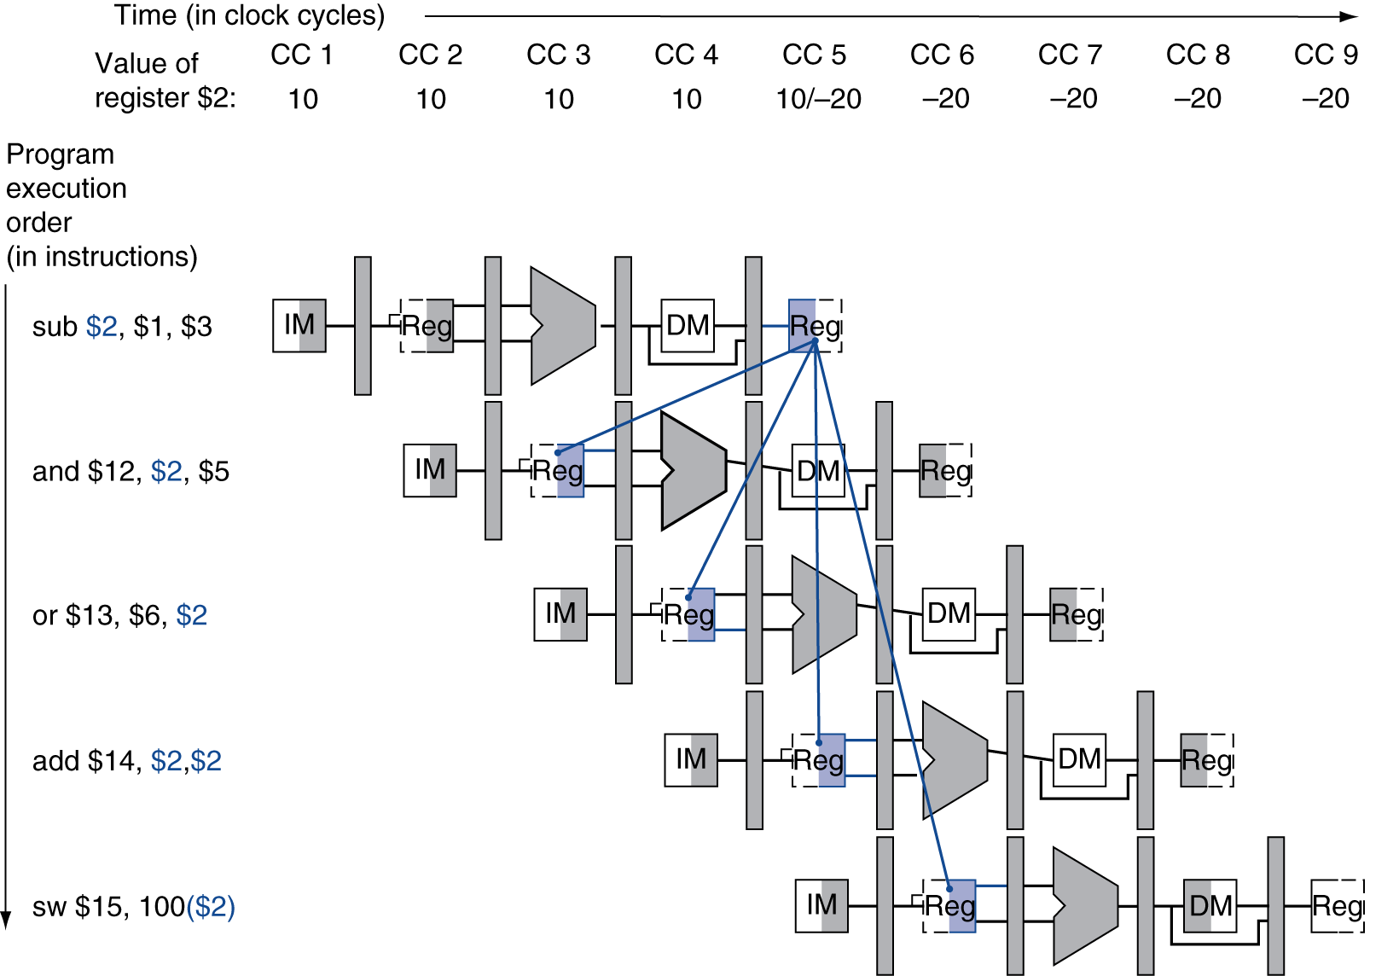
Forwarding from Registers
Forwarding

Slide 9
Dependencies & Forwarding
Forwarding
How to detect data
hazard for forwarding?
Multi-driver

Slide 10
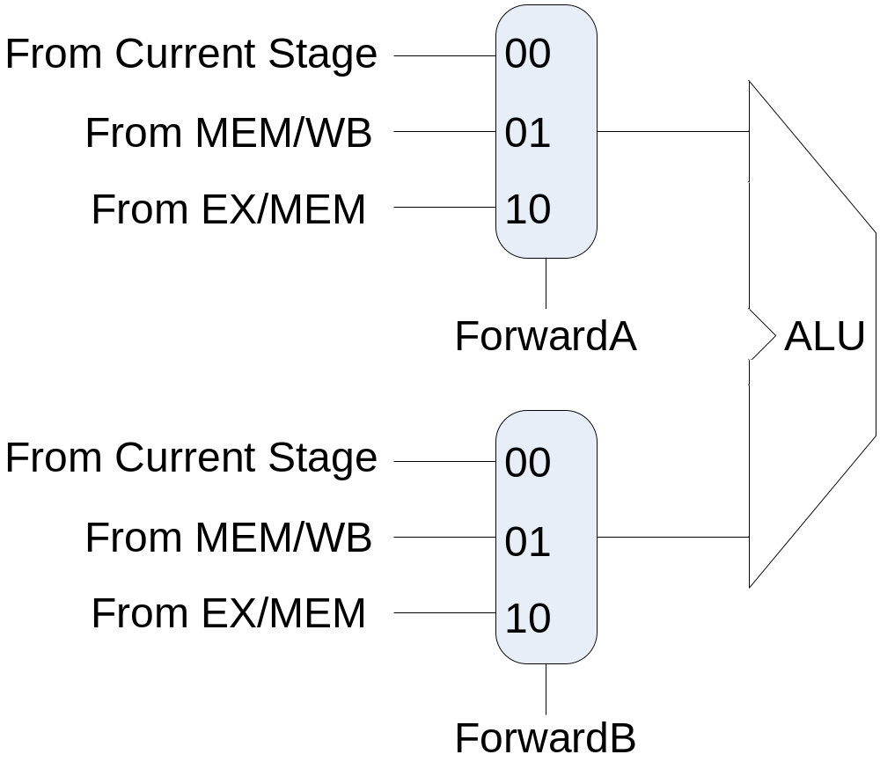
Forwarding Path
Forwarding paths are created between stage pipeline registers and ALU inputs
  By using MUXes

Slide 11
Detect the Condition for Forwarding
Denotation:
  E.g. ID/EX.RegisterRs = register number for Rs residing in ID/EX pipeline register
ALU operand register numbers in EX stage are given by
  ID/EX.RegisterRs, ID/EX.RegisterRt
Data hazard conditions include
  1a. EX/MEM.RegisterRd==ID/EX.RegisterRs
  1b. EX/MEM.RegisterRd==ID/EX.RegisterRt
  2a. MEM/WB.RegisterRd==ID/EX.RegisterRs
  2b. MEM/WB.RegisterRd==ID/EX.RegisterRt
Fwd from
EX/MEM
pipeline reg
Fwd from
MEM/WB
pipeline reg

Slide 12
Detecting the Need to Forward
Only if an earlier instruction will write back to a register, determined by
  EX/MEM.RegWrite
  MEM/WB.RegWrite
And only if Rd for that instruction is not $zero (constant register), determined by
  EX/MEM.RegisterRd ≠ 0
  MEM/WB.RegisterRd ≠ 0

Slide 13
Revised Forwarding Conditions
EX hazard
  if (EX/MEM.RegWrite and (EX/MEM.RegisterRd ≠ 0)
  and (EX/MEM.RegisterRd = ID/EX.RegisterRs))
  MUX select signal ForwardA = 10
  if (EX/MEM.RegWrite and (EX/MEM.RegisterRd ≠ 0)
  and (EX/MEM.RegisterRd = ID/EX.RegisterRt))
  MUX select signal ForwardB = 10
MEM hazard
  if (MEM/WB.RegWrite and (MEM/WB.RegisterRd ≠ 0)
  and (MEM/WB.RegisterRd = ID/EX.RegisterRs))
  MUX select signal ForwardA = 01
  if (MEM/WB.RegWrite and (MEM/WB.RegisterRd ≠ 0)
  and (MEM/WB.RegisterRd = ID/EX.RegisterRt))
  MUX select signal ForwardB = 01

Slide 14
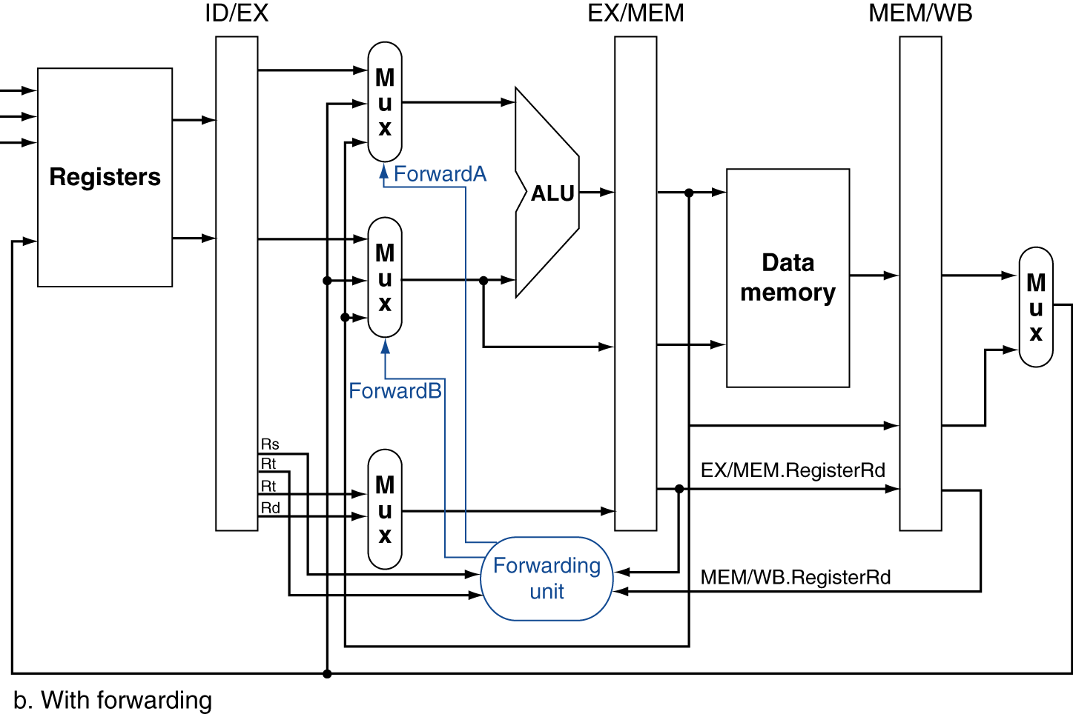
Forwarding Paths
Forwarding Unit in EX stage

Slide 15
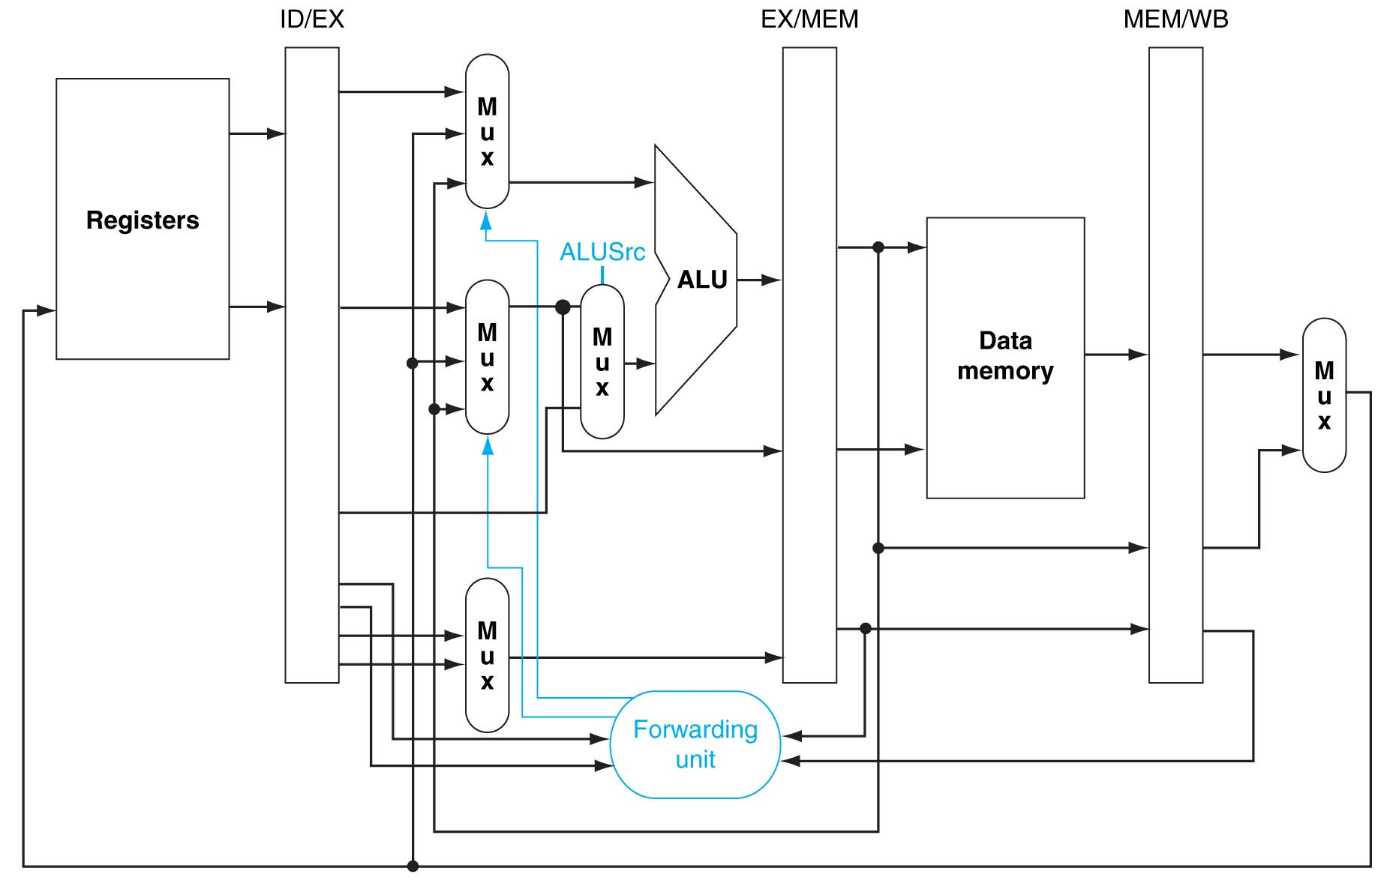
Forwarding Paths with ALUSrc

Slide 16
Double Data Hazard
Consider the sequence:
  add $1,$1,$2
  add $1,$1,$3
  add $1,$1,$4
Conditions for both hazards are satisfied
  Want to use the most recent
  Forwarding between 1st and 3rd – MEM hazard condition should be disabled
Revise MEM hazard condition
  Only fwd if EX hazard condition isn’t true

Slide 17
Revised Forwarding Condition
MEM hazard (not EX hazard)
  if (MEM/WB.RegWrite and (MEM/WB.RegisterRd ≠ 0)
  and (MEM/WB.RegisterRd = ID/EX.RegisterRs)
  and not (EX/MEM.RegWrite and (EX/MEM.RegisterRd ≠ 0)
  and (EX/MEM.RegisterRd = ID/EX.RegisterRs)) )
  ForwardA = 01
  if (MEM/WB.RegWrite and (MEM/WB.RegisterRd ≠ 0)
  and (MEM/WB.RegisterRd = ID/EX.RegisterRt)
  and not (EX/MEM.RegWrite and (EX/MEM.RegisterRd ≠ 0)
  and (EX/MEM.RegisterRd = ID/EX.RegisterRt)) )
  ForwardB = 01

Slide 18
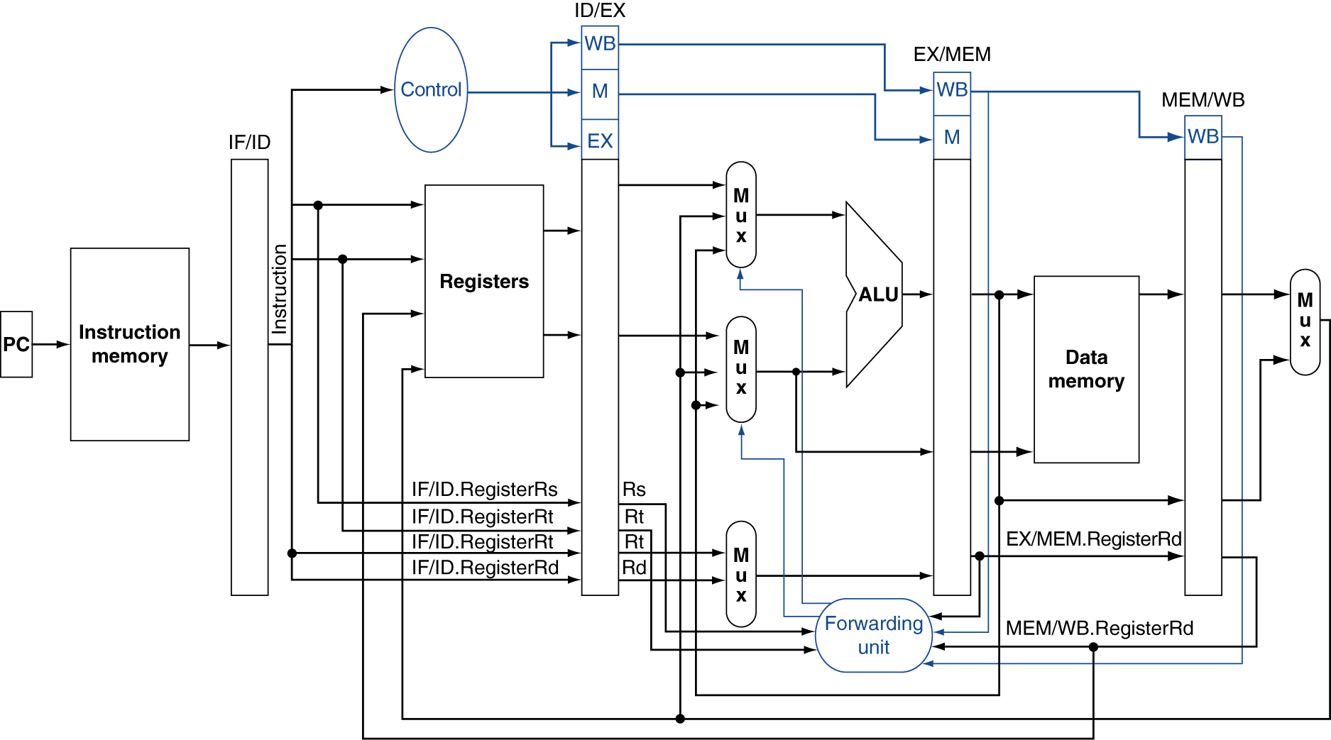
Datapath with Forwarding Unit

Slide 19
Load-Use Data Hazard
Can’t always avoid stalls by forwarding
  If value not computed when needed
  Can’t forward backwards in time!

Slide 20
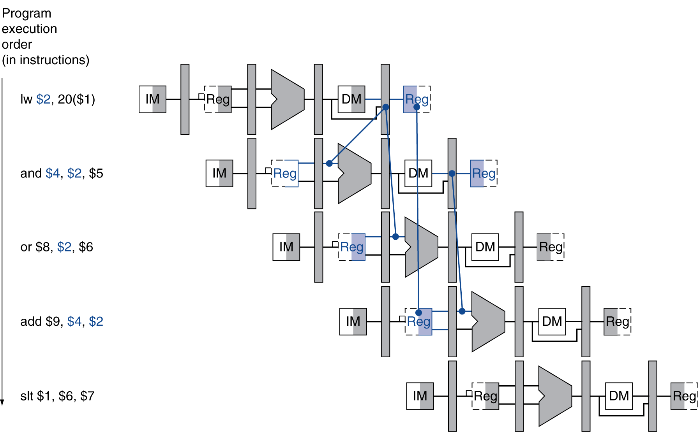
Load-Use Data Hazard
Referring data in later time.
Need to stall for one cycle

Slide 21
Load-Use Hazard Detection
Need to check only for a load instruction, determined by
  ID/EX.MemRead
Load-use hazard when
  ID/EX.MemRead and
  ((ID/EX.RegisterRt == IF/ID.RegisterRs) or
  (ID/EX.RegisterRt == IF/ID.RegisterRt))
Hazard Detection is in ID stage
If detected, stall and insert bubble

Slide 22
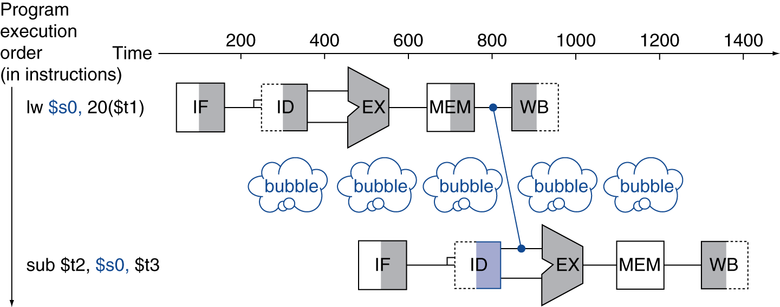
Load-Use Data Hazard
Resolve by inserting stalls
nop

Slide 23
How to Stall the Pipeline?
Force control signals in ID/EX register
to 0’s
  EX, MEM and WB in following cycles do no-operation (nop) with those 0 control signals
Prevent updates of PC and IF/ID registers
  Instruction in IF/ID is held and decoded again
  PC is held, so the same instruction is fetched again

Slide 24
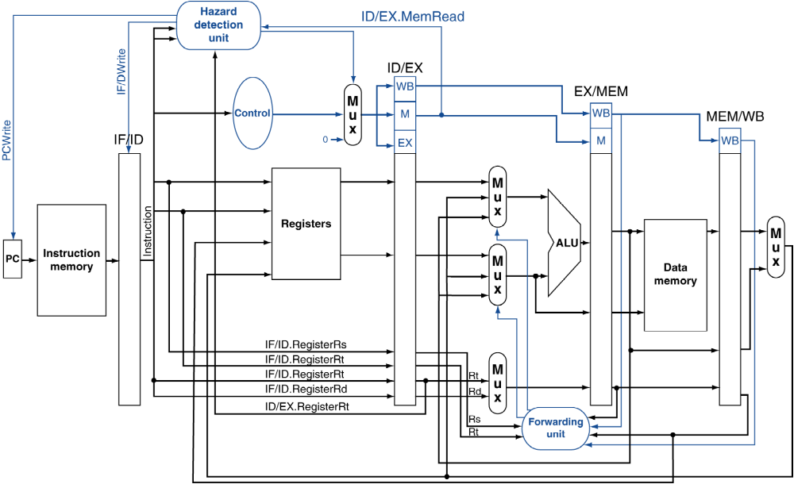
Datapath with Hazard Detection

Slide 25
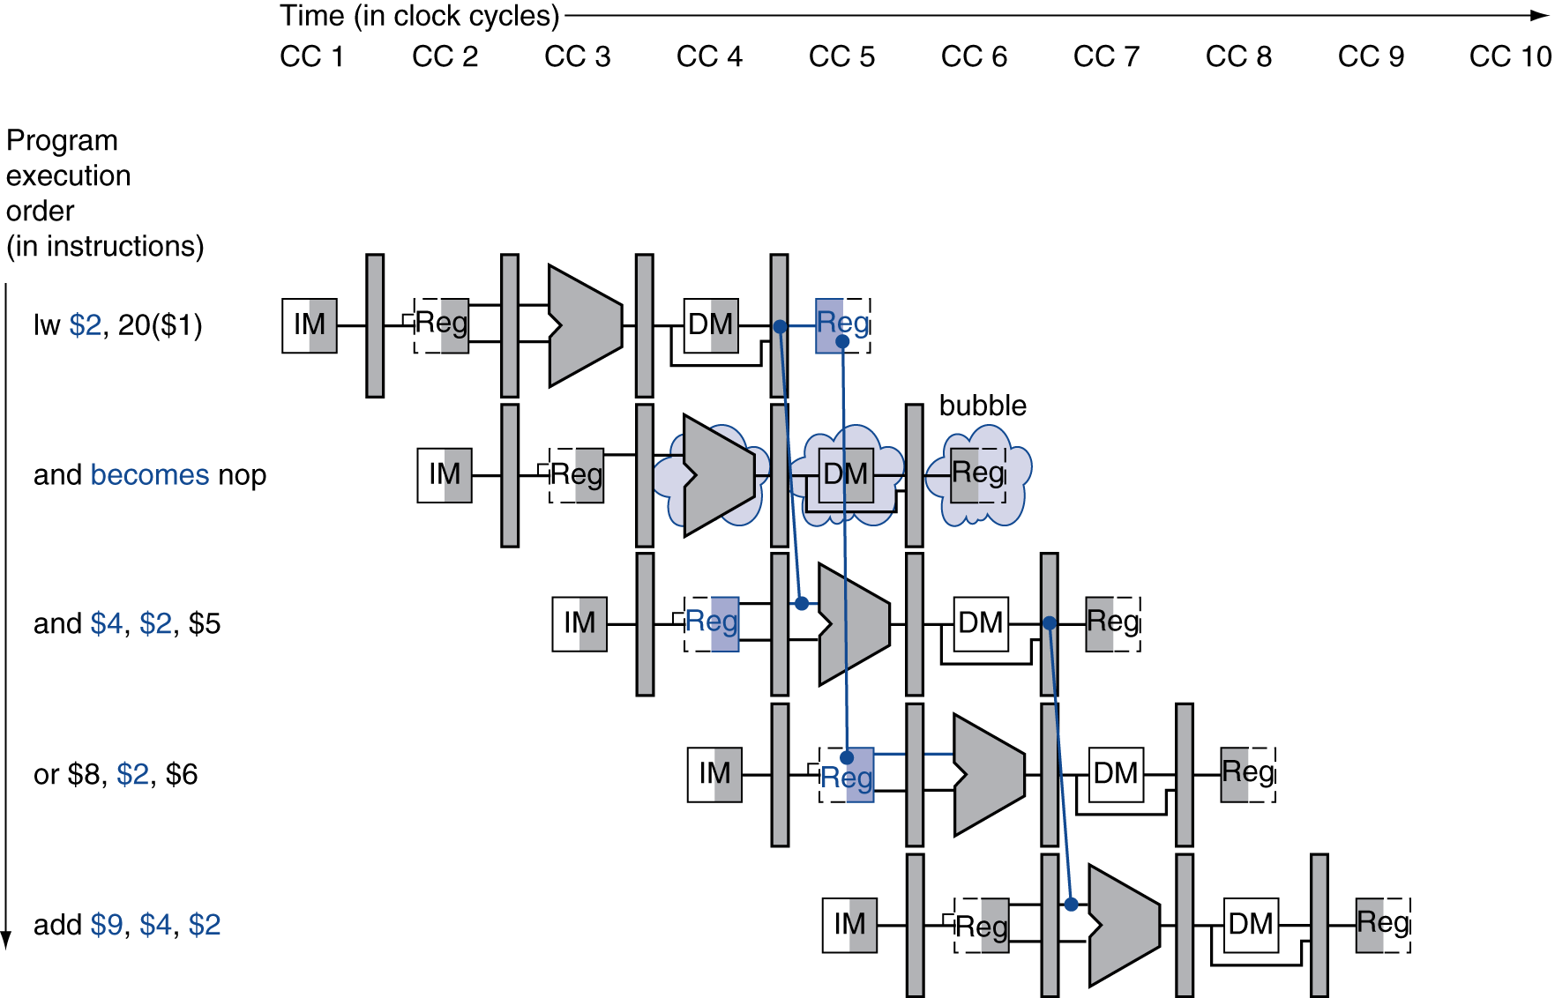
Stall/Bubble in the Pipeline
“and” is fatched, but stall inserted here
“and” is fetched and decoded again here

Slide 26
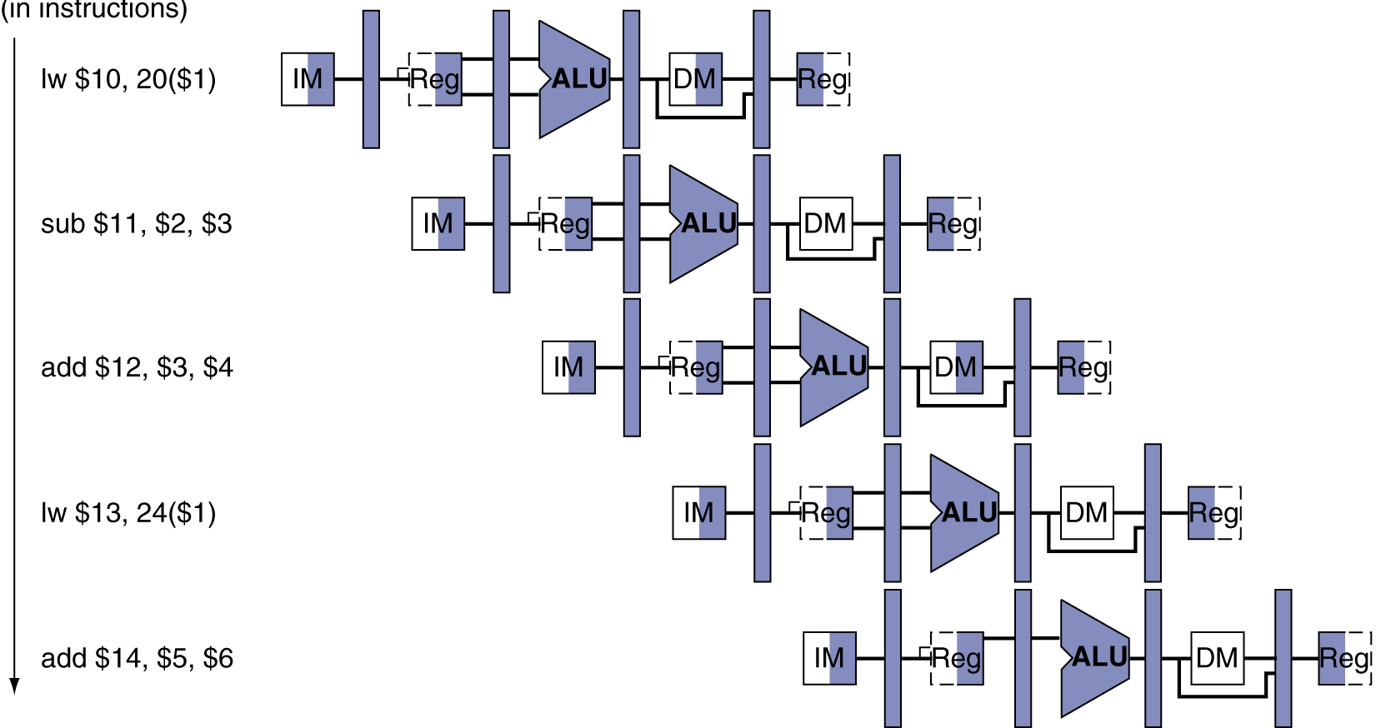
Question
How to implement?
sw $10, 40($1)
sw $10, 40($1)
sw $10, 40($1)
add $12, $3, $4
This delays the execution too much, how to fix?

Slide 27
Code Scheduling to Avoid Stalls
Reorder code to avoid use of load result in the next instruction
C code for A = B + E; C = B + F;
lw $t1, 0($t0)
lw $t2, 4($t0)
add $t3, $t1, $t2
sw $t3, 12($t0)
lw $t4, 8($t0)
add $t5, $t1, $t4
sw $t5, 16($t0)
lw $t1, 0($t0)
lw $t2, 4($t0)
lw $t4, 8($t0)
add $t3, $t1, $t2
sw $t3, 12($t0)
add $t5, $t1, $t4
sw $t5, 16($t0)
stall
stall
13 cycles
11 cycles

Slide 28
Stalls and Performance
The BIG Picture
Stalls reduce performance
  But are required to get correct results
Hardware can be improved to take care of the hazards automatically
  forwarding
Compiler can arrange code to avoid hazards and stalls
  Requires knowledge of the pipeline structure

